Slide 1

Ambiguities and Safeguards of Language

Slide 2
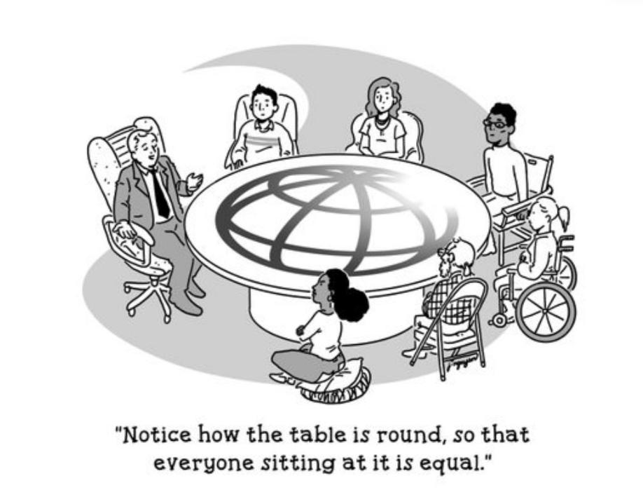

Slide 3
Workplace Language Discrimination

Slide 4
Problem🡪
Biases/Prejudices: Personal Traits
Affect workplace functioning
Solution🡪
Avoid discriminatory language (methodological shift)
Avoid discriminatory ways of thinking (personality shift)

Slide 5
Discrimination Based On:
Gender
Sexuality
Class (Language)
Region
Race
Ethnicity
Age
Others

Slide 6
Examples of Consciously Framed Discriminatory Language:
Gendered language, assumptions about productivity relating to pregnancy/marital engagements
Heteronormative language
Racialized: “shabby/dirty”,“glowing complexion”, Professional choice of representatives/ front desk staff

Slide 7
Regionalist:
Discriminating based on language accents (hiring people for top posts if they demonstrate certain accents),
Indicating preferences or personal stereotypes of region-based behaviour (“That’s typical of North India / of the South)
Speaking by homogenizing regions (the ‘North-East’/’North India’/’South India’)
Classist (Lack of privilege/exposure/access)

Slide 8
Some Strategies:
Avoid gender-specific language, Use gender-neutral/inclusive language
Use gender-inclusive pronouns: they/their instead of he/his or she/her;
Be inclusive in your language: Instead of “Good morning, Ladies and Gentleman” start with “A very good morning everyone . . .”, “May the best person win” instead of “May the best man win”
Say “Spouses/partners” instead of “Husbands/wives”, “Parenthood leave” instead of “Maternity/Paternity leave”

Slide 9
Prepare a clear and detailed workplace policy, Circulate the written document, Have policies for behaviour and language usage, Cover/Anticipate a broad range of potential discriminatory acts, Provide training sensitization programs for employees/students and for your team leaders (Second-level of administration should model appropriate behaviour)
Avoiding biases in workplace policies
Nothing is “just banter/good fun/in jest/ unintentional”

Slide 10
Companies-> speak to a clientele in a marketplace (Advertising): Advertisers pitch to a certain section (a specific class, a specific body-type etc) [Examples on the following slide] As teachers/seniors/enterpreneurs/students/employees🡪 we speak to a professional audience (not a clientele/market): As professionals we do not pitch to specific sections (inclusivity is essential)

Slide 11


Slide 12
